Slide 1
WSL(Windows Subsystem for Linux): Another way to use Linux Environments
HGU

Slide 2
What is WSL (Widnows Subsystem for Linux)?
Windows Subsystem for Linux (WSL) is a feature of Microsoft Windows that offers a convenient way to run any kinds of Linux environment without the need for a separate virtual machine or dual booting. ➔ Revolutionary to developers !
Prerequisite: 64-bits windows 10 or more
WSL 1 : released 2016 : No emulation and virtualization, But direct use of filesystem and some hardware (network), Not all Linux system call was implemented
WSL 2 : released 2019 : runs inside Linux Virtual machine, supports real Linux full Kernel, guarantees backward compatibility to WSL1

Slide 3
WSL2 Performance
CPU and Memory: WSL 2 provides near-native performance for CPU and memory operations because it's using a real Linux kernel, (though there may still be some overhead due to the virtualization layer.)
Virtual Machine: runs a full Linux kernel in a lightweight virtual machine (VM) using Hyper-V. This gives WSL 2 much better compatibility with Linux applications as well as performance that is closer to native Linux.
File System Performance: uses an ext4 file system inside a virtual hard disk (VHD) file for its Linux root filesystem, which generally provides much better performance for file operations compared to WSL 1.
However, accessing files on the Windows filesystem (/mnt/c, etc.) can still be slower compared to accessing files on the native ext4 filesystem.

Slide 4
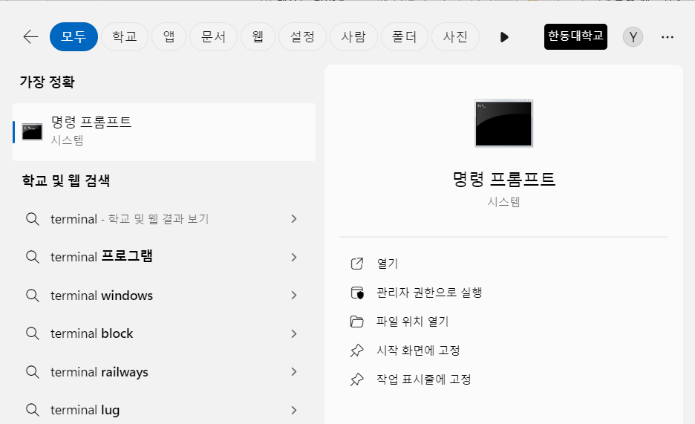

WSL.EXE command to Manage Distribution
Open Powershell on Win11 (search terminal or cmd)
WSL.exe command manages distribution of WSL.
list available distributions,
set a default distribution,
uninstall distributions.
run Linux binaries from the Windows Command Prompt
Checking wsl status
C:\> wsl –status
C:\> wsl –l -v

Slide 5
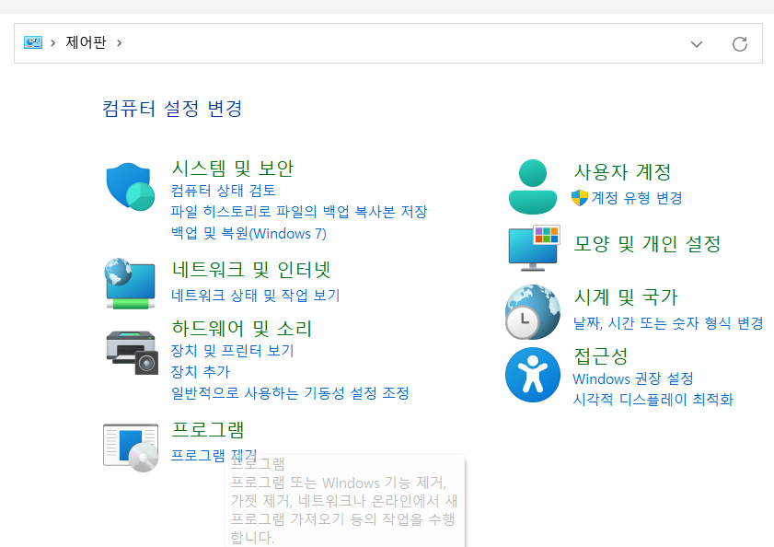
Enabling WSL
Sometimes, WSL is not enabled ➔ need turn on the WSL features on Win11
1. Open Control panel
(제어판)
2. Open Program

Slide 6
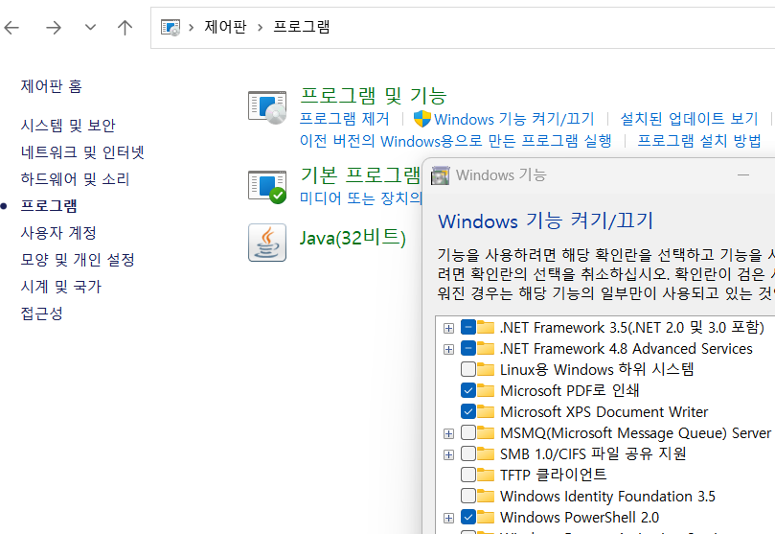
Enabling WSL
Turn Windows features on or off
(Windows 기능
켜기/끄기)

Slide 7
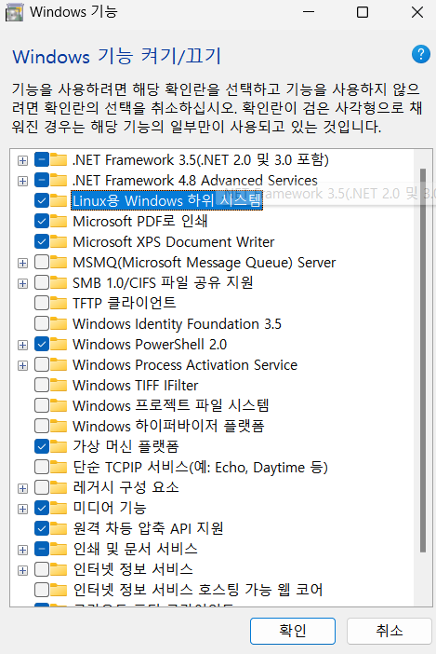
Enabling WSL
Turn on
Windows subsystem for Linux (Linux용 Windows 하위 시스템)
Virtual Machine Platform
(Windows 가상머신)
확인
Windows 추가 구성 요소 자동 설치

Slide 8
Installing WSL
Begin installation by WSL.exe command on Terminal
C:\> WSL --install
… Ubuntu is installing process begins
Enter your user name and password
Reboot windows

Slide 9
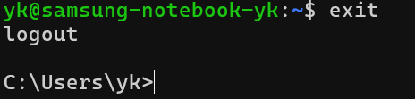
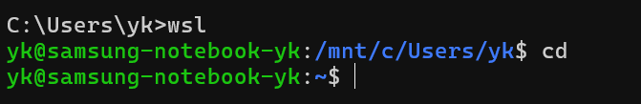
Start Linux with WSL (on Terminal)
Check WSL status
C:\>WSL -l -v
Start WSL
C:\> WSL
In Ububtu, Logout
Exit WSL
$ exit
In Windows
WSL start in Windows
In Ububtu

Slide 10
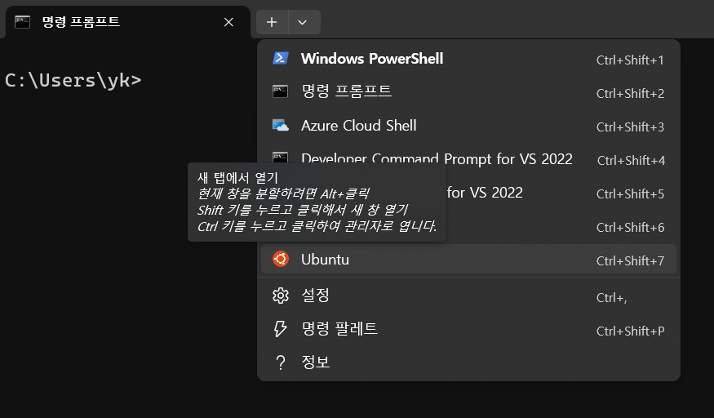
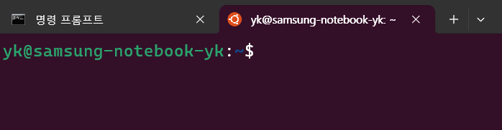
Another way to start Linux (Ubuntu) with WSL
On Terminal Title bar
Select New Tab → Ubuntu

Slide 11
WSL Filesystem
WSL filesystem format: ext4
Root filesystem(/) : stored in a virtual disk image (ext4.vhdx)
Windows Drives (/mnt/c, /mnt/d, etc.): Use NTFS format, accessible via the DrvFS layer in WSL.
WSL provides seamless interoperability between the Linux environment and the Windows filesystem.
Temporary Filesystem (/tmp): Typically uses tmpfs, stored in memory. and removed whenever WSL restart

Slide 12
Windows Filesystem access from WSL
Windows “C:” drive filesystem is mounted at /mnt/c of WSL
You can use Linux cp/mv Linux command to copy/move files between Windows and Linux filesystems
Windows
filesystem
Linux filesystem
of WSL
C drive
C:\
/mnt/c

Slide 13
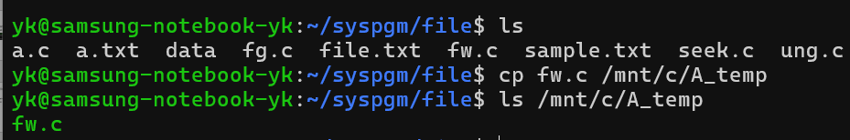
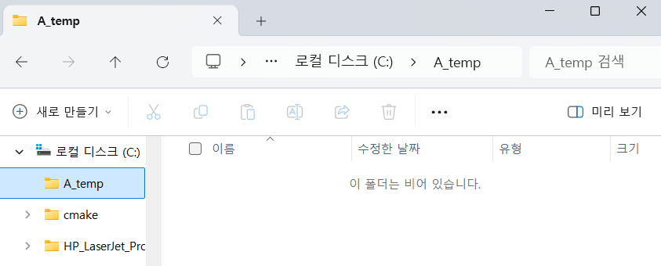
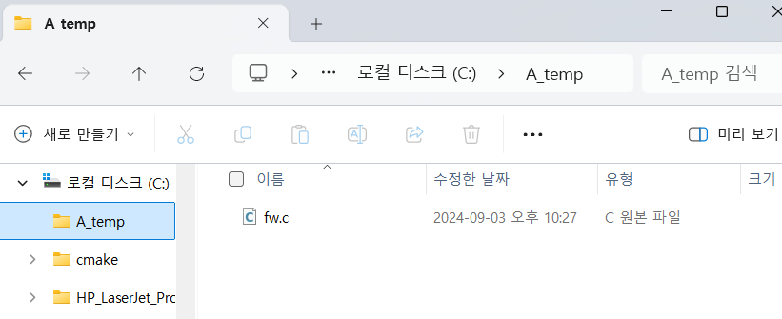
Demo : Copy a file from Linux filesystem to Windows filesystem (window C: ⬄ Linux /mnt/c)

Slide 14
All Linux Features are available in WSL
Program Development Environments
vi
nano
vscode
gcc
gdb
make
cmake
prof …
Using Open source
Programming Language support
Linux System calls are supported
X11 graphics GUI are available
File Systems are ext4 format

Slide 15
Have Fun with WSL !

